Slide 1

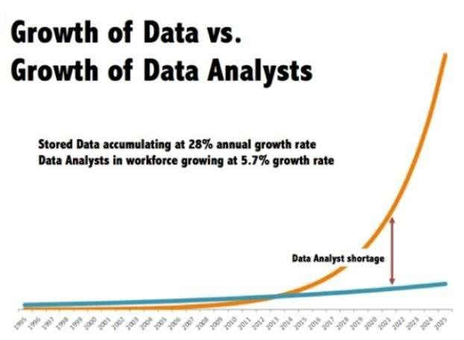
Why we are talking about Data Science?

Slide 2
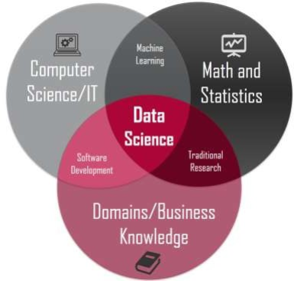
What is Data Science?
Data science is the field of study that combines 1. Domain expertise 2. Programming skills 3. Knowledge of mathematics 4. Statistics to extract meaningful insights from data.

Slide 3
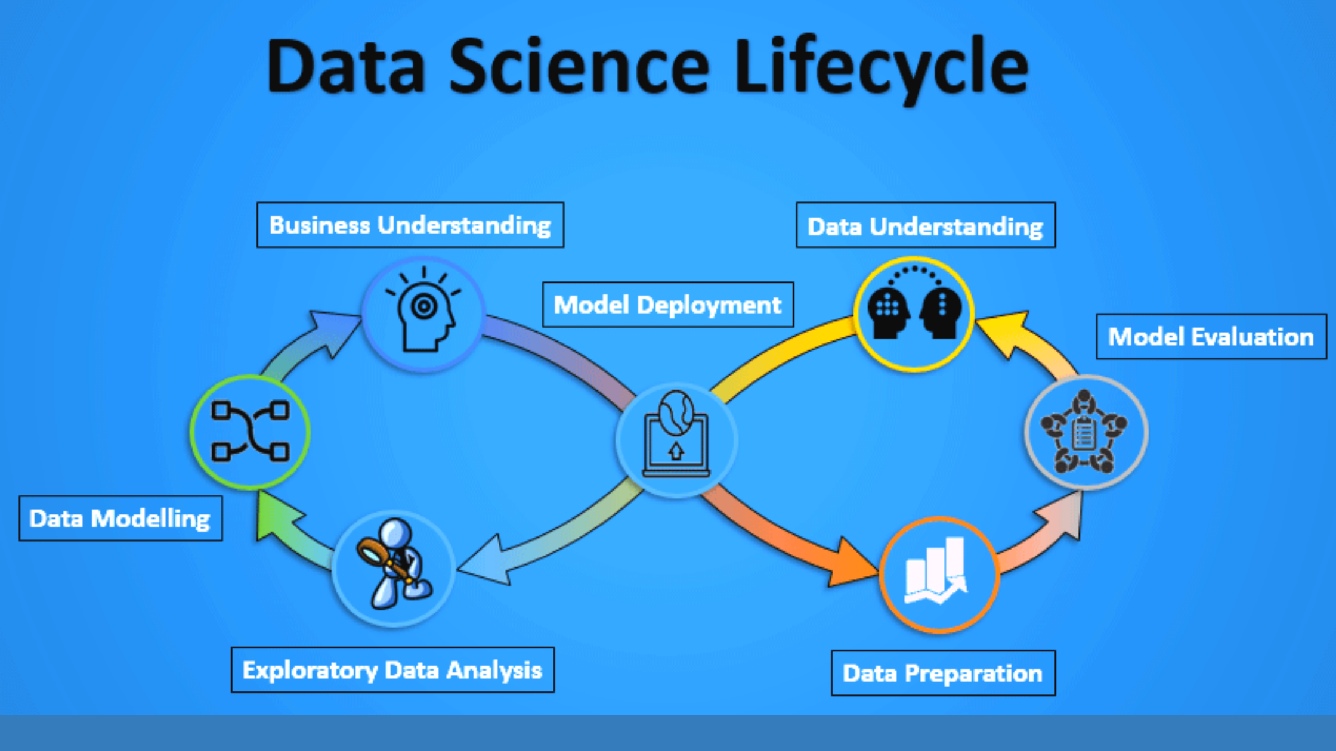
Life Cycle of Data Science projects

Slide 4
Data Science Process flow
Obtaining Data
Scrubbing Data
Exploring Data
Modelling Data
Interpreting Data

Slide 5
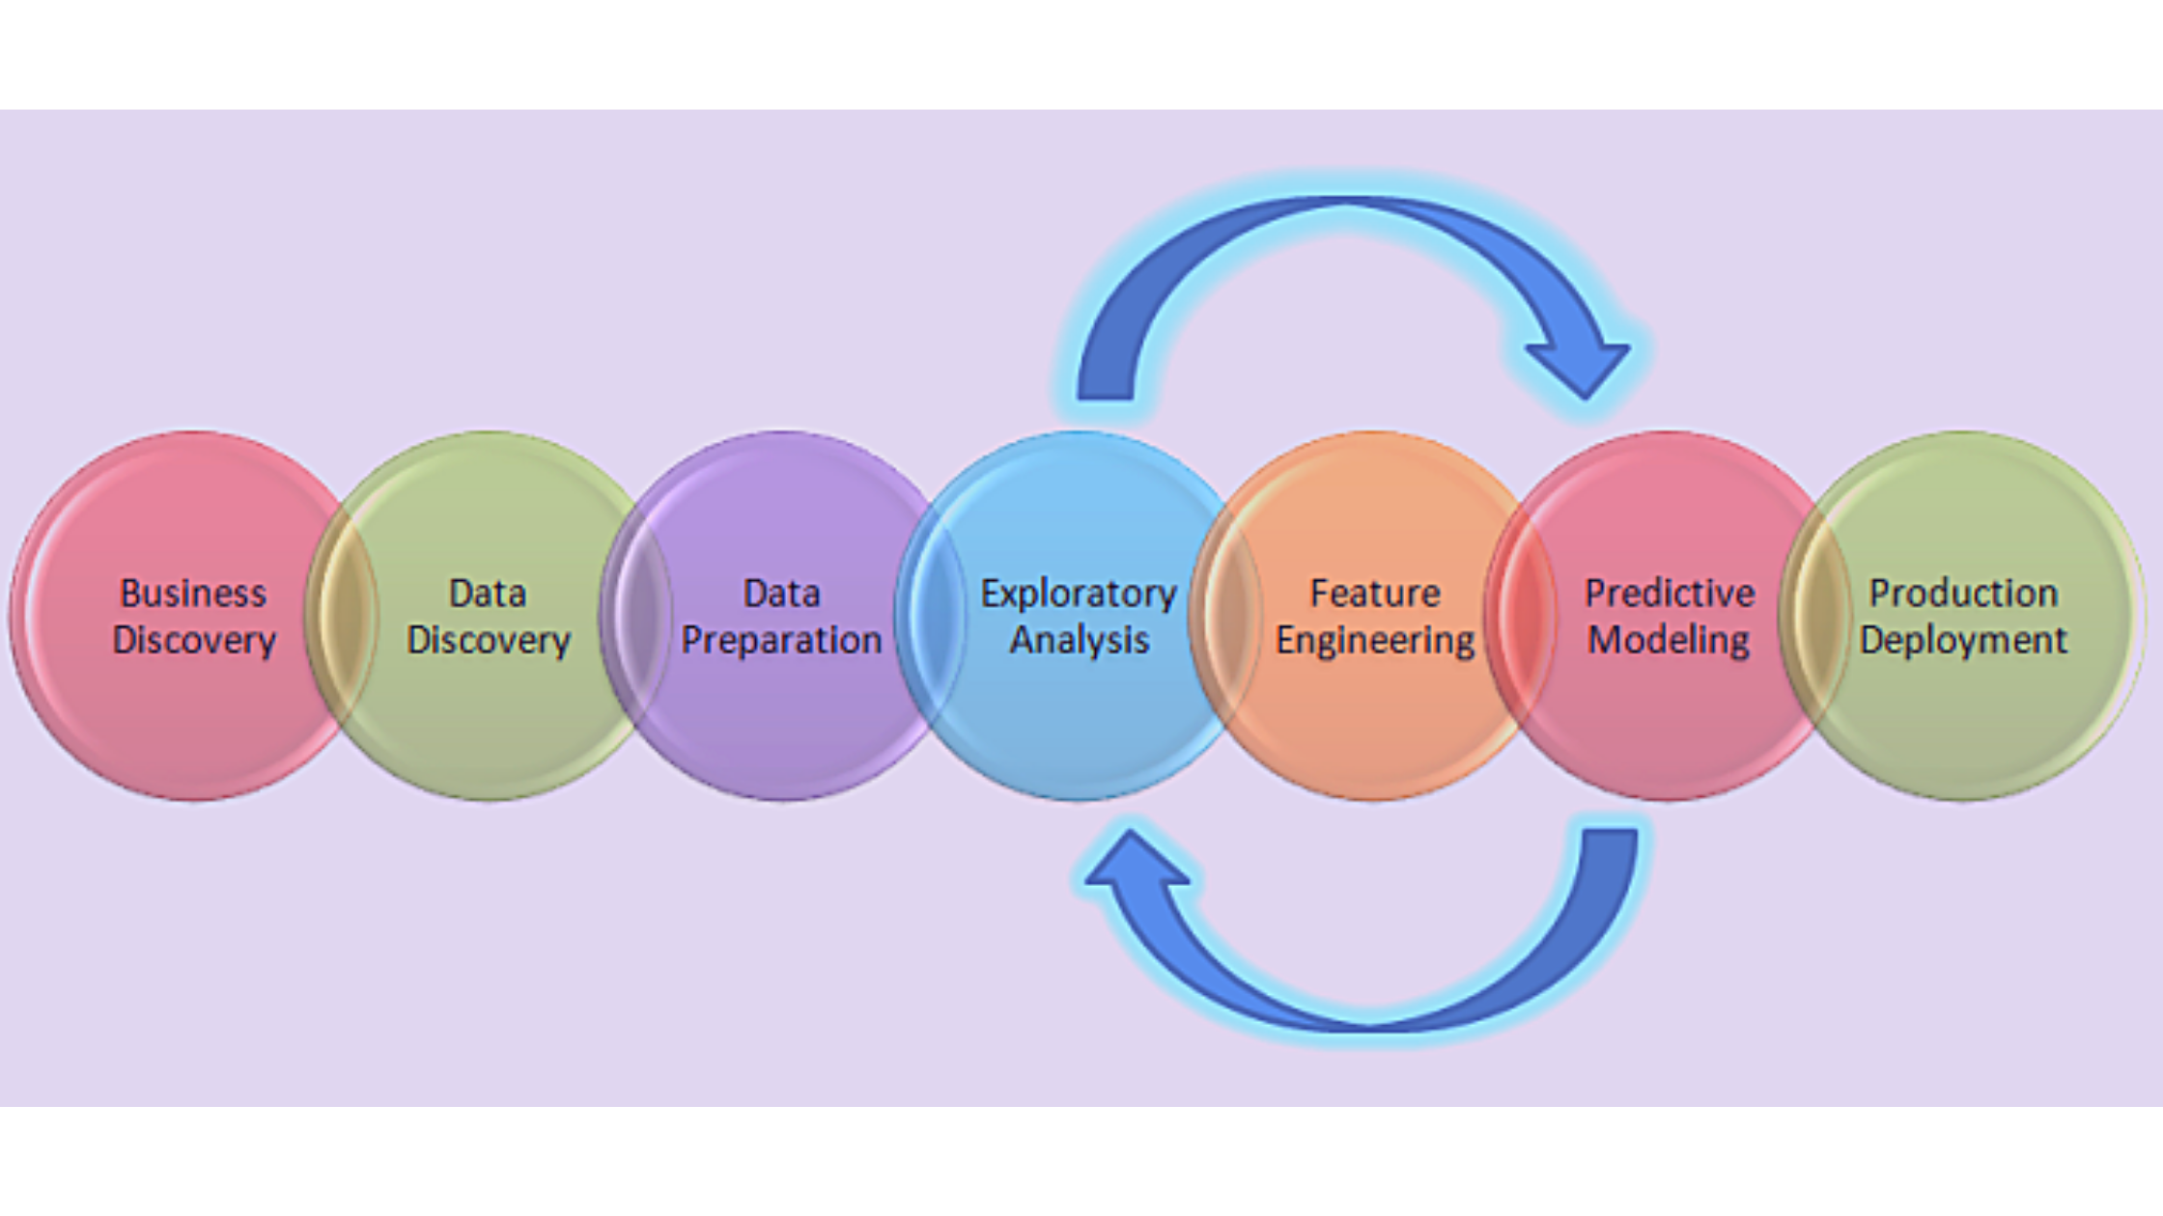
Life Cycle of Data Science projects

Slide 6
Who Are Involved in The Projects
Business Analyst
Data Analyst
Data Scientists
Data Engineer
Data Architect
Machine Learning Engineer

Slide 7
Data Science Roles
Data Engineers
– Focus on Obtaining and Scrubbing the data
Data Analysts
– Explore, Model and Interpret the data to make sense of the data collected
Data Scientists
– Oversee the entire project from end to end, so you are able to architect the entire data
framework, and eventually bringing it through the production process

Slide 8
Understanding the Business Problem
Understand the business problem that the client is facing
Take consultation from domain experts and understand the underlying problems that are present in the system
A Business Analyst is generally responsible for gathering the required details from the client and forwarding the data to the data scientist team for further speculation

Slide 9
Data Collection
Collect relevant data to break the problem into small components
The data science project starts with the identification of various data sources, which may include web server logs, social media posts, data from digital libraries such as the US Census datasets, data accessed through sources on the internet via APIs, web scraping, or information that is already present in an excel spreadsheet
The data analyst team is responsible for gathering the data

Slide 10
Obtaining Data collect and obtain the data we need
Method Skill Set
query database - MySQL/PostgreSQL/MongoDB(Non Structured)
web scraping - Python
connecting to Web APIs - (FB/Twitter) their web API to crawl their data
directly from files, CSV/TSV
bigger data sets or Big Data - Apache Hadoop, Spark or Flink

Slide 11
Data Preparation
Understand the data and prepare it for further evaluation - Data Cleaning or Data Wrangling
Exploratory Data Analysis (EDA) is critical at this point because summarising clean data enables the identification of the data’s structure, outliers, anomalies, and trends
These insights can aid in identifying the optimal set of features, an algorithm to use for model creation, and model construction

Slide 12
Scrubbing Data Clean and filter the data
To convert the data from one format to another and consolidate everything into one standardized format across all data
Data mining tools like Python / R – scripting
Data wrangling tools – Pandas, basic Python / R – processing
Big data sets – Hadoop, spark or Map Reduce – scrub the data and run the scripting

Slide 13
Exploring Data Inspect the data and all its properties
data characteristics / Different type of data
compute descriptive statistics to extract features and test significant variables
the characteristics that represent this database
identify patterns and trends in your data
Skill set - Using Python- Numpy, Matplotlib, Pandas or Scipy
Using R – GGplot2, Dplyr
skills in experimental design, inferential statistics and data visualization

Slide 14
Data Modelling
The core process- we take the prepared data as the input and with this, we try to prepare the desired output
Select the appropriate type of model -the problem is a regression problem or classification, or a clustering-based problem
Choose the appropriate machine learning algorithm that is best suited for the model
Evaluate the model by testing the accuracy and relevance.
Make sure there is a correct balance between specificity and generalizability, which is the created model must be unbiased

Slide 15
Modelling Data Reduce the dimensionality of your data set
Regression and predictions - to forecast future values
Classification - to identify and group
Skill set
Machine Learning - both supervised and unsupervised algorithms
Evaluation methods like linear algebra, multivariate calculus, probability

Slide 16
Model Deployment
Ensure that we have picked the right solution after a rigorous evaluation has been. it is then deployed in the desired channel and format.
Make sure that the model is deployed properly and accepted in the real world as an optimal use case - Rigorous testing in every step

Slide 17
Interpreting Data Presentation of your data
Actionable insights
Visualize your findings
Skill set
strong business domain knowledge to present your findings
soft skills like presenting and communication skills

Slide 18
Understanding the Applications of Data Science
The main areas where Data Science techniques are being used are
Marketing: Marketing has a lot of potential; for example, a better pricing approach. Data Science-driven pricing can help companies like Uber and E-Commerce enterprises increase their profitability.
Healthcare: Wearable Data is being used to monitor and prevent health issues. The information gathered from the body can be utilized in healthcare to avoid future disasters.
Banking and Finance: Data Science can be used in the Banking sector. Fraud Detection is one of the well-known applications in this sector, which can help banks lower their non-performing assets.

Slide 19
Different PROJECT TYPES
Descriptive Analytics - a sales team wants to look at sales by demographics by customer, gender, age, territory, region, market
Predictive Analytics - using customer demographics, the sales team wants to predict buying behavior in-store vs online
Prescriptive Analytics - determine optimal sales and marketing strategies — what types of products pair well together, pricing and discount strategies, for sales uplift
Sentiment analysis - can include customer support analysis or customer feedback analysis to determine the affinity of customers towards a product/brand
Detection Projects - Detect anomalies in product sales
Deep Learning or Neural Networks - predict sales of each of x products for the following year in each of the different outlets
Clustering and classification - what customer is the most likely or unlikely to buy a product X

